Slide 1

UniGNN: a Unified Framework for Graph and Hypergraph Neural Networks
BIG DATA ANALYTICS COMP4434_20242_A: Group 29
Group member:
Siu Yau Shing
Lam Yam Ying
Kan Wai Yi

Slide 2
Table of Contents
Abstract
Background Knowledge
GNNs
Hypergraphs
HGNNs
Dataset
Methodology
Results
Comparisons

Slide 3
Abstract/Background of Paper
IJCAI-21
Attempt to apply Graphical Neural Network (GNN) network design and learning strategy towards Hypergraph Neural Networks (HGNNs)
Solve problem of over-smoothing, an issue when node embeddings in GNNs tend to converge as layers are stacked up and the performance downgrades significantly
Analyse how powerful are HGNNs

Slide 4
Results of Paper
UniGNN, a unified framework for interpreting the message passing process in graph and hypergraph neural networks, which can generalize general GNN models into hypergraphs
Creation of UniGCNII, the first deep hypergraph neural network to solve the over-smoothing issue
Evaluate the UniGNN framework and UniGCNII Neural Network using datasets

Slide 5
GNNs (Graphical Neural Networks)
A type of Neural Network that works with Graphs
Nodes represent objects, and Edges represent relationship/connections between them
Nodes aggregate information from their neighbors, enabling the model to learn representations that incorporate both local graph structure and node features.

Slide 6
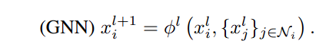
How GNNs Work
Message Passing:
Nodes iteratively collect "messages" (feature vectors) from their neighbors.
These messages are aggregated (e.g., summed, averaged) and combined with the node's own features.
This process is repeated across multiple layers, allowing nodes to capture information from increasingly distant neighbors.
Learning Representations:
Each layer updates node embeddings (low-dimensional vectors) by blending neighborhood data with the node’s current state.
The final embeddings can be used for tasks like node classification, link prediction, or graph classification.

Slide 7
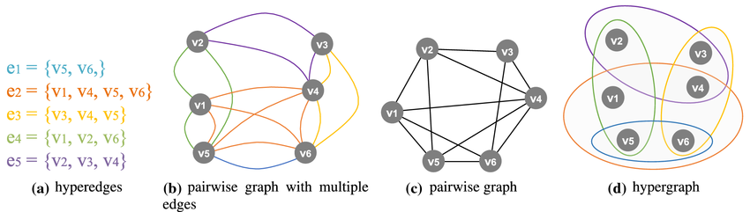
What are Hypergraphs
Hypergraphs have edges that can connect any number of nodes, where a normal graph have edges that connect only 2 nodes
Hypergraphs: Capture group interactions instead of binary relationships (e.g., co-authors in a paper, ingredients in a recipe).

Slide 8
HGNNs (Hypergraph Neural Networks)
Neural Networks that are designed to model and learn from hypergraphs
Unlike GNNs, which propagate information along edges between pairs of nodes, HNNs aggregate information across all nodes connected by a hyperedge, enabling the modeling of higher-order dependencies

Slide 9
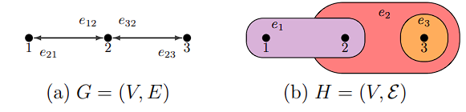
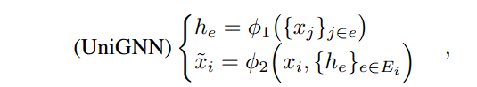
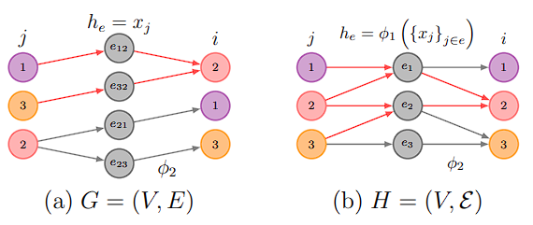
UniGNN: a Unified Framework
Stage 1: Hyperedge Aggregation (ϕ1​)
For each hyperedge e, aggregate the features of all nodes in e, where ϕ1​ is permutation-invariant (e.g., sum, mean, or a learnable function). This produces a hyperedge representation that summarizes the nodes
Stage 2: Node Update (ϕ2​)
For each node i, aggregate the representations of all hyperedges where ϕ2​ is another permutation-invariant function. This step combines the node’s own features ​ with aggregated hyperedge information.

Slide 10
UniGNN: a Unified Framework
4 GNNs were then modified to become HGNNs
GCN -> UniGCN
GAT -> UniGAT
GIN -> UniGIN
GraphSAGE -> UniSAGE
2 tasks were used to evaluate the hgnns with other preexisting models:
1.Semi-supervised Hypernode Classification
2. Inductive Learning on Evolving Hypergraphs
a variant of the 1-dimensional Generalized Weisfeiler-Leman Algorithm (1-GWL) for hypergraph isomorphism test is used to determine the accuracy of the models

Slide 11
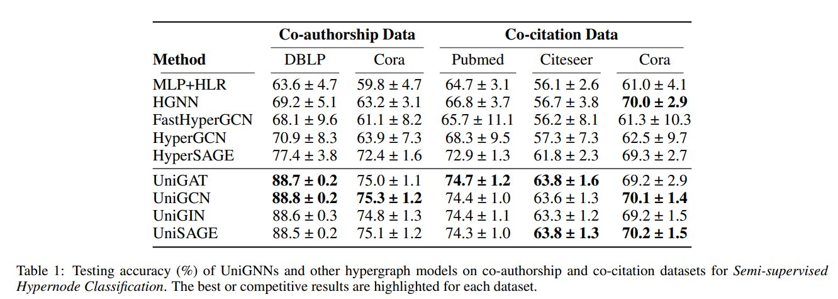
Semi-supervised Hypernode Classification
The task is a semi-supervised hypernode classification task aims to predict labels for the test nodes, given the hypergraph structure, all nodes’ features and very limited training labels

Slide 12
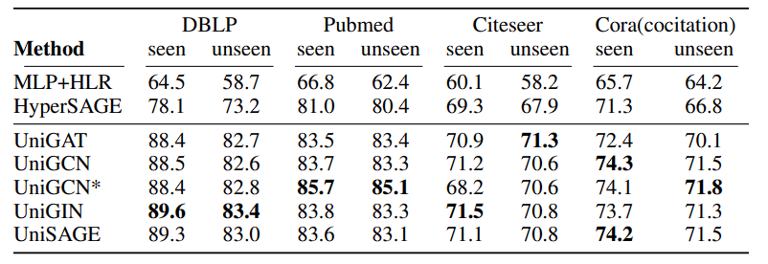
Inductive Learning on Evolving Hypergraphs
The task for inductive learning on evolving hypergraph takes the historical hypergraph as input and predicts the unseen nodes’ labels

Slide 13
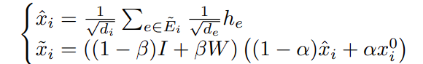
UniGCNII, the first deep hypergraph neural network
Generalise GCNII, a powerful deep graph convolutional network enhanced with Initial Residual Connection and Identity Mapping, to vanquish the oversmoothing problemto become UNIGCNII
where α and β are hyperparameters, I is identity matrix and x 0 i is the initial feature of vertex i

Slide 14

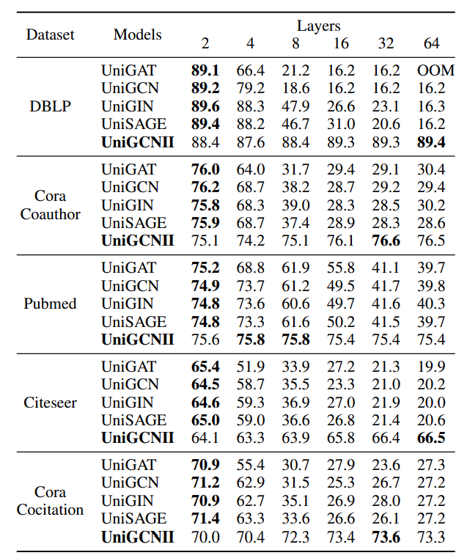
Performance of UniGCNII compared to other HGNNs
The experiment uses the same setting as described in the semi-supervised hypernode classification task, except that additional 20% of the original testing split is used as the validation split.
the performance of vanilla models drop significantly as depths increase while unigcnii performance increases

Slide 15
Dataset
The dataset used for UniGNN is DBLP, Pubmed, Citeseer and Cora
Pubmed be dataset, thedata size 19717 x 500 > 1000000
Due the Dataset training set and test set are fixed, we no need using k-fold to do cross-validation
Hypergraph is created with each vertex representing a document
The semi-supervised hypernode classification task aims to predict labels for the test nodes, given the hypergraph structure, all nodes’ features and very limited training labels.

Slide 16
Methodology
Traditional machine learning algorithms
Random Forest
Support vector machine (SVM)
Neural network
Multi-layer perceptron (MLP)
Complicated neural network architectures
ModifiedGNN
Each run 10 times to test the model

Slide 17
Our Design for a new solution
Our designs new graph neural network architecture, ModifiedGNN, which is specifically designed to process complex graph structured data. combines:
Multi-scale information propagation
Multi-layer nonlinear transformation
Residual connections and learned information gating
more effectively capture the deep relationships and contextual information between nodes.

Slide 18
Results
Accuracy:
Paper design: UNIGNN(UniSAGE model): 72.1498Our Design:
SVM: 70.4547
Random Forest: 73.8098
MLP: 67.0884
ModifiedGNN: 72.5607

Slide 19
Comparison
UNIGNN (Paper): serves as a reference for performance Model.
Our Model:
Modified GNN: Slightly or nearly better than the paper model.
Random Forest: Achieves the highest accuracy among all models.
SVM & MLP: Show lower accuracy compared to the paper's model.

Slide 20
References
https://arxiv.org/abs/2105.00956
code: https://github.com/OneForward/UniGNN

